Slide 1

COMPUTER NETWORKS (BCSC 0008)
SWITCHING TECHNIQUES

Slide 2
Text and Reference Books
Text Books:
Fourouzan B. A. (2004), “Data Communication and Networking”, 4th Edition, McGraw-Hill.
References:
Kurose, J. F. and Ross K. W. (2005), “Computer Networking: A Top-Down Approach Featuring the Internet”, 3rd Edition, Addison-Wesley.
A. S. Tanenbaum (2006), “Computer Networks”, 2nd Edition, Prentice Hall India.

Slide 3
Previous discussed topics:
OSI Model
TCP/IP Model
Addressing
Data & Signals
Transmission Media & Line Encoding
Now we will discuss:
Concept of Switch
Circuit, Packet and Message Switching Techniques

Slide 4
Q:A network is a set of connected devices. Whenever we have multiple devices, we have the problem of how to connect them to make one-to-one communication possible. List Possible solutions.
Sol:1-One solution is to make a point-to-point connection between each pair of devices (a mesh topology).
Sol:2-Point-to-point connection between a central device and every other device (a star topology).
Issues with these methods:
These methods, however, are impractical and wasteful when applied to very large networks.
The number and length of the links require too much infrastructure to be cost-efficient, and the majority of those links would be idle most of the time
Sol:3-Other topologies employing multipoint connections, such as a bus
Issues with these methods:
the distances between devices and the total number of devices increase beyond the capacities of the media and equipment
Optimal Solution
Switching.

Slide 5
SWITCH
We use switches in circuit-switched and packet-switched networks.
A switch is a device in a computer network that connects other devices together. Multiple data cables are plugged into a switch to enable communication between different networked devices.
A switch is a device that is used at the Access or OSI Layer 2; a switch can be used to connect multiple hosts (PCs) to the network.

Slide 6
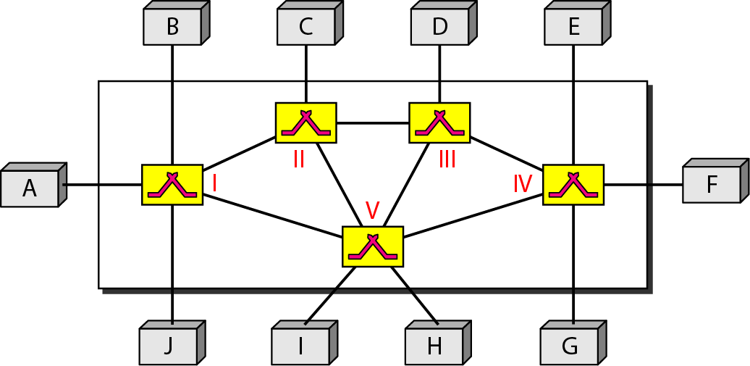
Switching Technique
How 2 devices communicate when there are many devices?
One alternative is to establish Point to Point connection between each pair of devices using mesh topology (which is highly complex)
The other alternative is to use switching techniques leading to switched connection network.
Switched network

Slide 7
Switching Technique – Beyond Simple Topology
Important Points:
The end devices that wish to communicate are called stations.
The switching devices are called as nodes.
Some node connects to other nodes and other nodes are attached to stations.
There exist multiple paths between source to destination pair for better network reliability.
Switching nodes have no concerned with content of data and hence provides routing facility that will move data from node to node until they reach destination.

Slide 8
Switching Technique – Beyond Simple Topology
There are three typical switching techniques available for digital traffic.
Circuit Switching (on physical layer)
Message Switching (on network layer)
Packet Switching

Slide 9
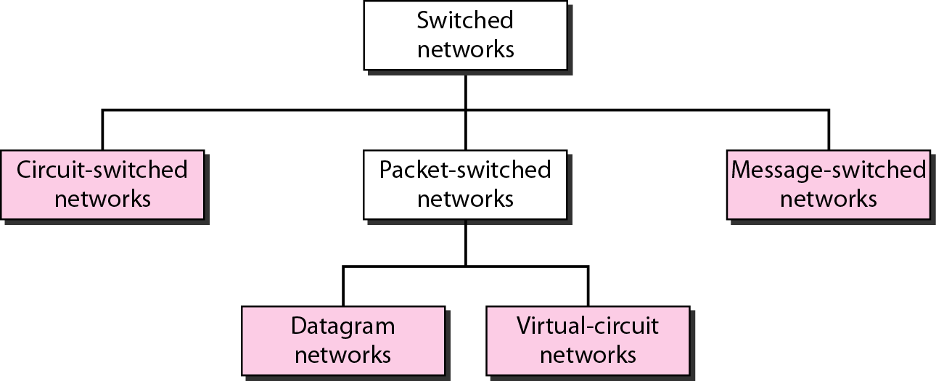
Taxonomy of switched networks

Slide 10
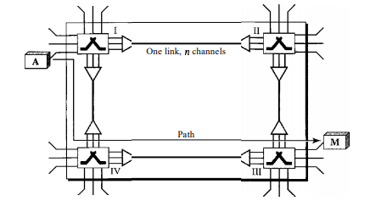
Basics of Circuit Switching
The end systems, such as computers or telephones, are directly connected to a switch. We have shown only two end systems for simplicity.
When end system A needs to communicate with end system M, system A needs to request a connection to M that must be accepted by all switches as well as by M itself.
This is called the setup phase; a circuit (channel) is reserved on each link, and the combination of circuits or channels defines the dedicated path.
After the dedicated path made of connected circuits (channels) is established, data transfer can take place. After all data have been transferred, the circuits are set down

Slide 11
CIRCUIT-SWITCHED NETWORKS
A circuit-switched network consists of a set of switches connected by physical links. A connection between two stations is a dedicated path made of one or more links. However, each connection uses only one dedicated channel on each link. Each link is normally divided into n channels by using FDM or TDM.
Circuit switching was designed in 1878 in order to send telephone calls through a dedicated channel.
This channel remains open and in use throughout the whole call and cannot be used by any other data or phone calls.

Slide 12
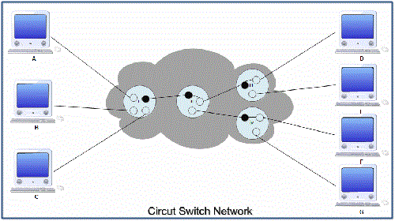
I II III
IV
It is the simplest method of data communication in which a dedicated physical connection or path is established between the sending and receiving device.
In circuit switched networks, a set of switches are connected by physical links. A connection between two stations is a dedicated path made of one or more links.
Figure shows a circuit switched network in which computer A, B and C are connected to computer D, E, F and G via four switches. If these computers are to be connected with a point-to-point connections, 12 dedicated lines are required which will incur high line cost.

Slide 13
The four switches connecting these computers thus provide dedicated links by reducing the line cost. Here I, II, III and IV are the circuit switches or nodes. Nodes I, III, IV are connected to computers while II is only routing node.
In circuit switching the routing decision is made when path is set up across the network. After the link has been set between the sender and receiver, the information is forwarded continuously over the link.
The dedicated path established between the sender and the receiver is maintained for entire duration of conversation.
This link or path is released only when data transmission between sender and receiver is over.

Slide 14
Circuit switching takes place at the physical layer.
Before starting communication, the stations must make a reservation of resources to be used during the communication. These resources can be switch buffers, switch processing time, switch input/output ports.
These resources remain dedicated during the entire duration of data transfer.
Data transferred between the two stations are not packetized (i.e. in form of packets).
The data are a continuous flow· sent by the source station and received by the destination station and there may be periods of silence.

Slide 15
There is no addressing involved in data transfer. The switches route the data based on their occupied band (FDM) or time slot (TDM). However, there is end-to-end addressing used during set up phase.
In telephone systems circuit switching is used.
The communication in a circuit switched network takes place in three phases:
A.Circuit establishment or setup phase.
B.Data transfer phase.
C.Circuit disconnects or tears down phase.

Slide 16
Circuit establishment or setup phase.
In circuit switched network, before actual data transfer takes place, a dedicated circuit or path is established between the sender and receiver.
For example, if station A is willing to send a message to station C, it first sends a message to node 2, requesting a connection to station C, using the dedicated link between station A and node 2.
Node 2 must find the next link in a route, leading to node 4. Based on routing information and availability, node 2 selects the circuit to node 5 and sends a message, requesting connection to station C.
So far, a dedicated path has been established from station A through node 2 to node 5. Node 5 now gets a channel to node 4 and internally connects it to the previously established path.
Node 4 completes the connection to station C. After completing the connection, a test is made to check whether station C is busy to accept the connection or not. That completes the circuit establishment phase.

Slide 17
Data transfer phase.
Actual data transfer between the source and destination takes place after the dedicated path is set up between them.
The data flows are continuous between sender and receiver.
There may be periods of silence in between. Generally all the internal connections are duplex.

Slide 18
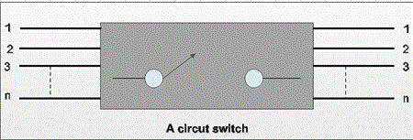
Circuit disconnects or tears down phase.
After the completion of data transfer, the established connection is terminated, and notification signal is propagated to all the nodes in the established path to release the dedicated resources.
Circuit switching can be an inefficient technique if the channel capacity is not used properly.
However, once the connection is established, data can be transmitted at full speed, supported by the channel.
This makes the complete utilization of the channel capacity.

Slide 19
Advantages of Circuit Switching
The advantages of circuit switching are:
The dedicated path/circuit established between sender and receiver provides a guaranteed data rate.
Once the circuit is established, data is transmitted without any delay as there is no waiting time at each switch.
Since a dedicated continuous transmission path is established, the method is suitable for long continuous transmission.

Slide 20
Disadvantages of Circuit Switching
The various disadvantages of circuit switching are:
As the connection is dedicated it cannot be used to transmit any other data even if the channel is free.
It is inefficient in terms of utilization of system resources.
As resources are allocated for the entire duration of connection, these are not available to other connections.
Dedicated channels require more bandwidth.
Prior to actual data transfer, the time required to establish a physical link between the two stations is too long.

Slide 21

Note
In circuit switching, the resources need to be reserved during the setup phase; the resources remain dedicated for the entire duration of data transfer until the teardown phase.
A circuit-switched network is made of a set of switches connected by physical links, in which each link is divided into n channels.
Switching at the physical layer in the traditional telephone network uses the circuit-switching approach.

Slide 22
Packet Switched Networks
In packet switched data networks all data to be transmitted is first assembled into one or more message units, called packets.
Packet switching is a connectionless network switching technique.
Here, the message is divided and grouped into a number of units called packets that are individually routed from the source to the destination.
There is no need to establish a dedicated circuit for communication.

Slide 23
Process
Each packet in a packet switching technique has two parts: a header and a payload.
The header contains the addressing information of the packet and is used by the intermediate routers to direct it towards its destination.
The payload carries the actual data.
A packet is transmitted as soon as it is available in a node, based upon its header information.
The packets of a message are not routed via the same path. So, the packets in the message arrives in the destination out of order.
It is the responsibility of the destination to reorde the packets in order to retrieve the original message.

Slide 24
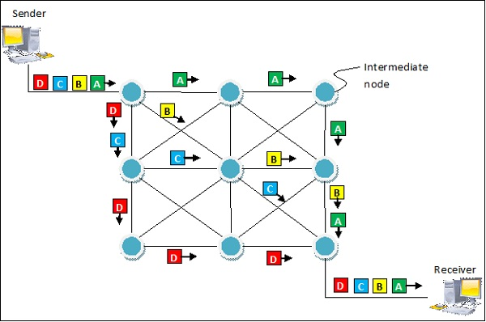
The process is diagrammatically represented in the following figure. Here the message comprises of four packets, A, B, C and D, which may follow different routes from the sender to the receiver.

Slide 25
Advantages
Delay in delivery of packets is less, since packets are sent as soon as they are available.
Switching devices don’t require massive storage, since they don’t have to store the entire messages before forwarding them to the next node.
Data delivery can continue even if some parts of the network faces link failure. Packets can be routed via other paths.
It allows simultaneous usage of the same channel by multiple users.
It ensures better bandwidth usage as a number of packets from multiple sources can be transferred via the same link.

Slide 26
Disadvantages
Packet switching high installation costs.
They require complex protocols for delivery.
Network problems may introduce errors in packets, delay in delivery of packets or loss of packets.
If not properly handled, this may lead to loss of critical information.

Slide 27
DATAGRAM NETWORKS
An Approach of Packet Switching
In data communications, we need to send messages from one end system to another.
If the message is going to pass through a packet-switched network, it needs to be divided into packets of fixed or variable size.
The size of the packet is determined by the network and the governing protocol.

Slide 28
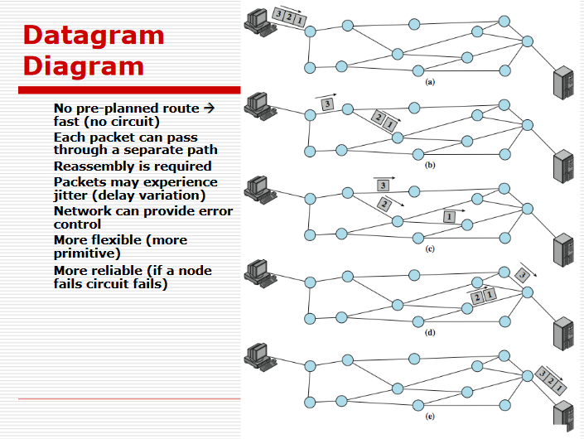
Packet Switching Datagram Approach –Connectionless

Slide 29
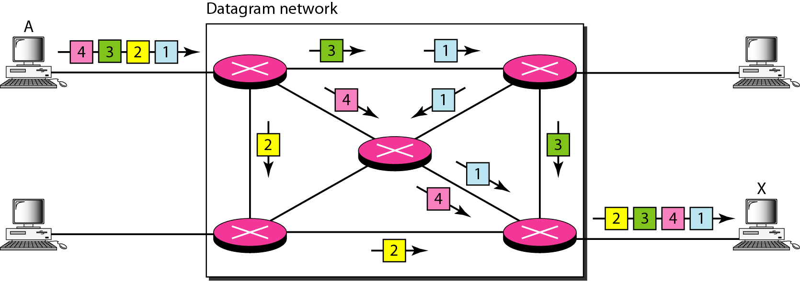
A datagram network

Slide 30
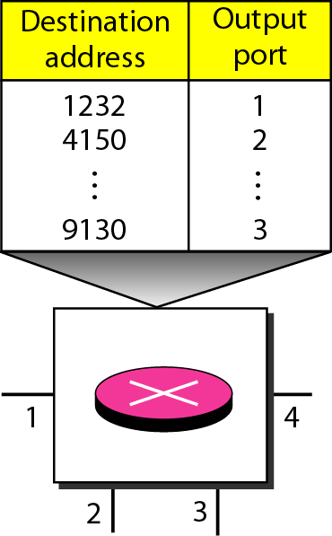
Routing table in a datagram network

Slide 31
Note
In a packet-switched network, there is no resource reservation; resources are allocated on demand.
A switch in a datagram network uses a routing table that is based on the destination address.
The destination address in the header of a packet in a datagram network remains the same during the entire journey of the packet.
Switching in the Internet is done by using the datagram approach to packet switching at the network layer.

Slide 32
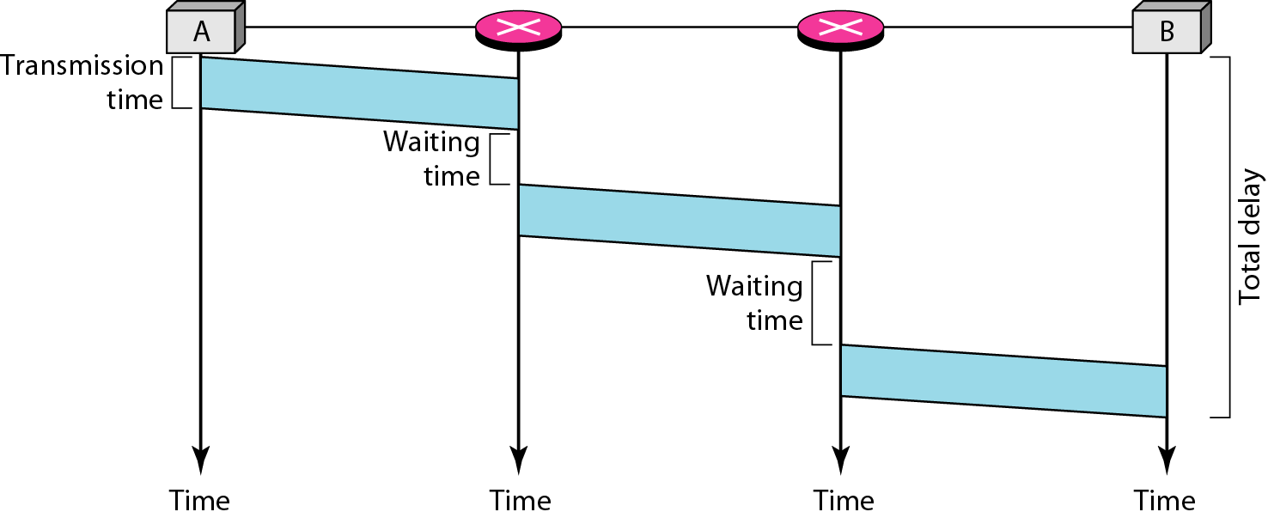
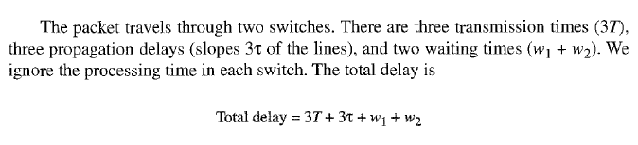
Delay in a datagram network

Slide 33
VIRTUAL CIRCUIT-SWITCHED NETWORKS
(An Approach of Packet Switching)
A virtual-circuit network is a cross between a circuit-switched network and a datagram network.
It has some characteristics of both.
As in a circuit-switched network, there are setup and teardown phases in addition to the data transfer phase.
Resources can be allocated during the setup phase, as in a circuit-switched network, or on demand, as in a datagram network.
However, the address in the header has local jurisdiction (it defines what should be the next switch and the channel on which the packet is being carried), not end-to-end jurisdiction
As in a circuit-switched network, all packets follow the same path established during the connection.
A virtual-circuit network is normally implemented in the data link layer, while a circuit-switched network is implemented in the physical layer and a datagram network in the network layer.

Slide 34
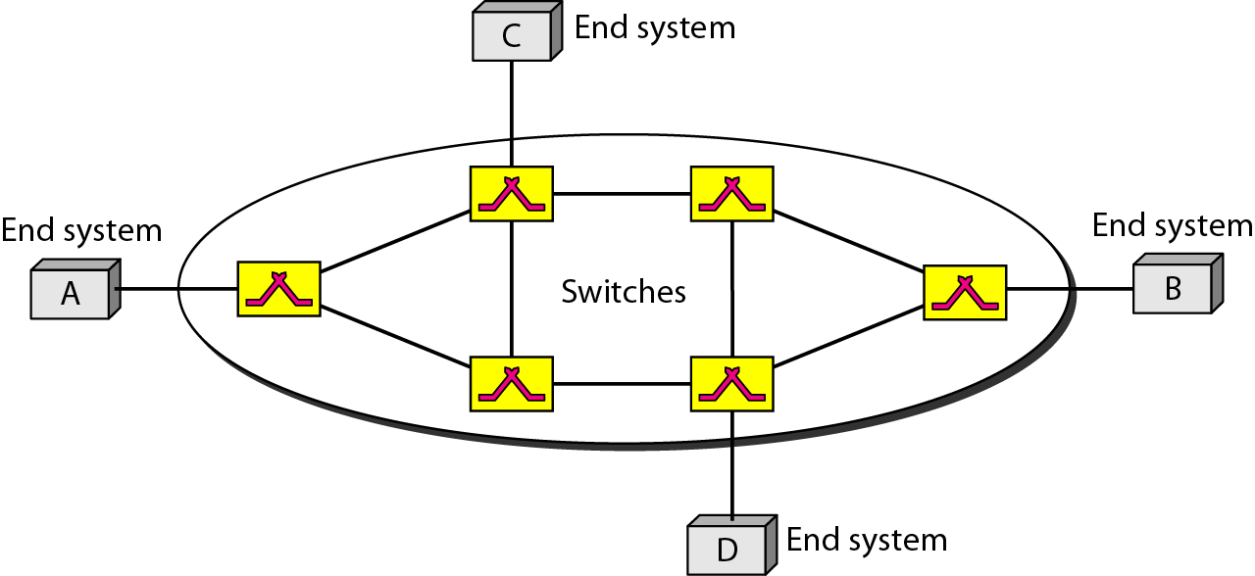
VIRTUAL CIRCUIT-SWITCHED

Slide 35
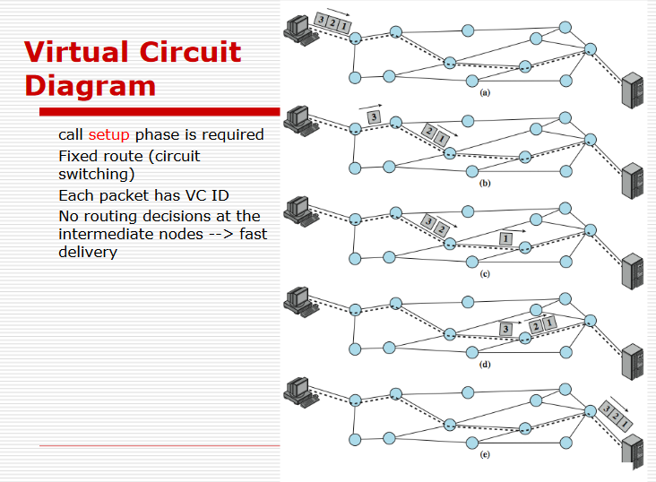
Packet Switching Virtual Circuit Approach
Connection Oriented

Slide 36
Packet Switching
Virtual Circuit Approach
How it is implemented ?
Addressing: In a virtual-circuit network, two types of addressing are involved:
Global
Local (VCI)
Global Addressing: A source or a destination IP address is considered to be global address.
Virtual-Circuit Identifier: The identifier that is actually used for data transfer is called the virtual-circuit identifier (VCI).
A VCI, unlike a global address, is a small number that has only switch scope.
It is used by a frame between two switches. When a frame arrives at a switch, it has a VCI; when it leaves, it has a different VCI.

Slide 37
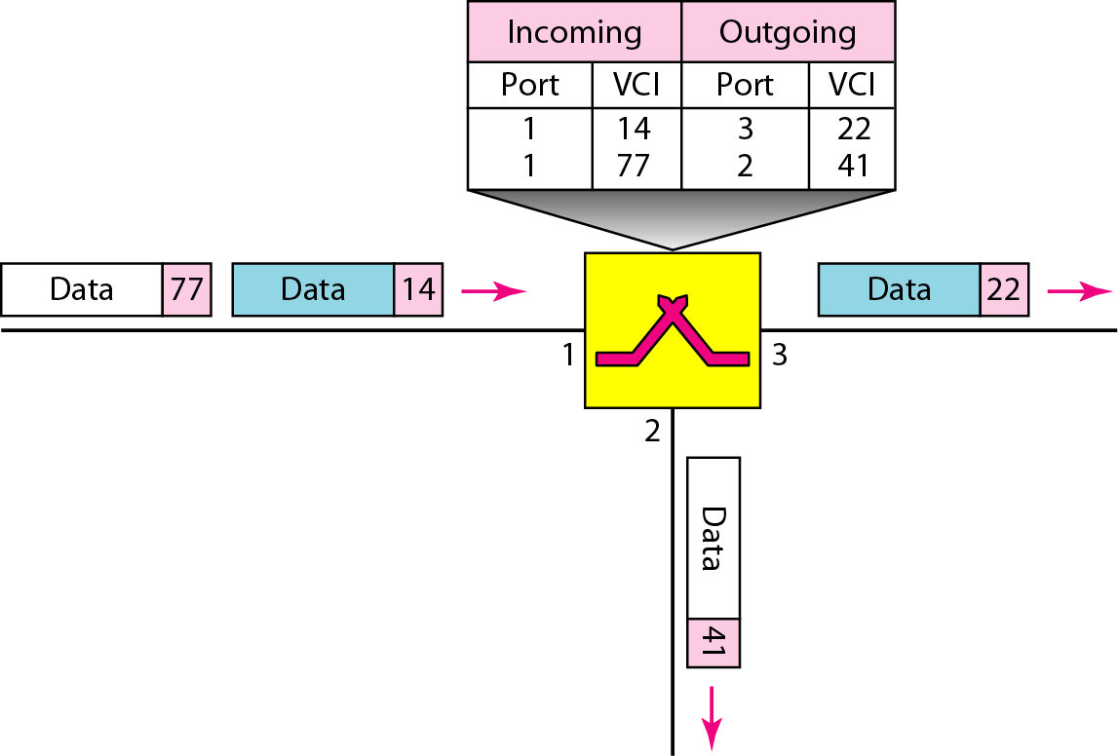
Switch and tables in a virtual-circuit network

Slide 38
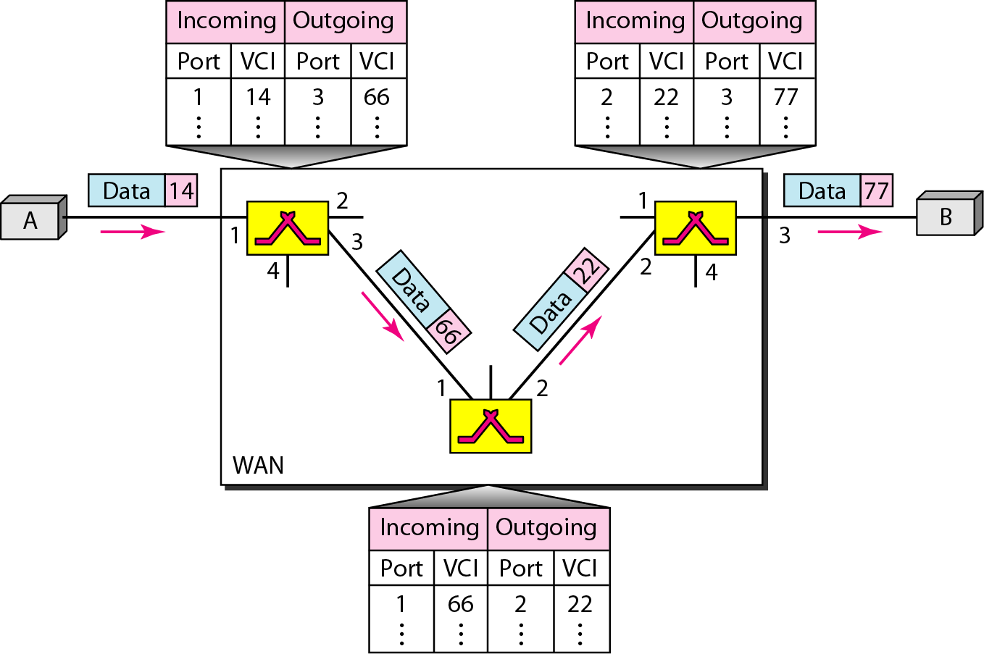
Source-to-destination data transfer in a virtual-circuit network

Slide 39
Packet Switching Virtual Circuit Approach
How Virtual Circuit is Established ?
Three Phases:
As in a circuit-switched network, a source and destination need to go through three phases in a virtual-circuit network: setup, data transfer, and teardown.
Setup phase, the source and destination use their global addresses to help switches make table entries for the connection.
In the teardown phase, the source and destination inform the switches to delete the corresponding entry.
Data transfer occurs between these two phases.

Slide 40
Packet Switching Virtual Circuit Approach
How Virtual Circuit is Established ?
Setup Phase:
In the setup phase, a switch creates an entry for a virtual circuit. For example, suppose source A needs to create a virtual circuit to B. Two steps are required: the setup request and the acknowledgment.
Setup Request: A setup request frame is sent from the source to the destination.
Acknowledgment: A special frame, called the acknowledgment frame, completes the entries in the switching tables.

Slide 41
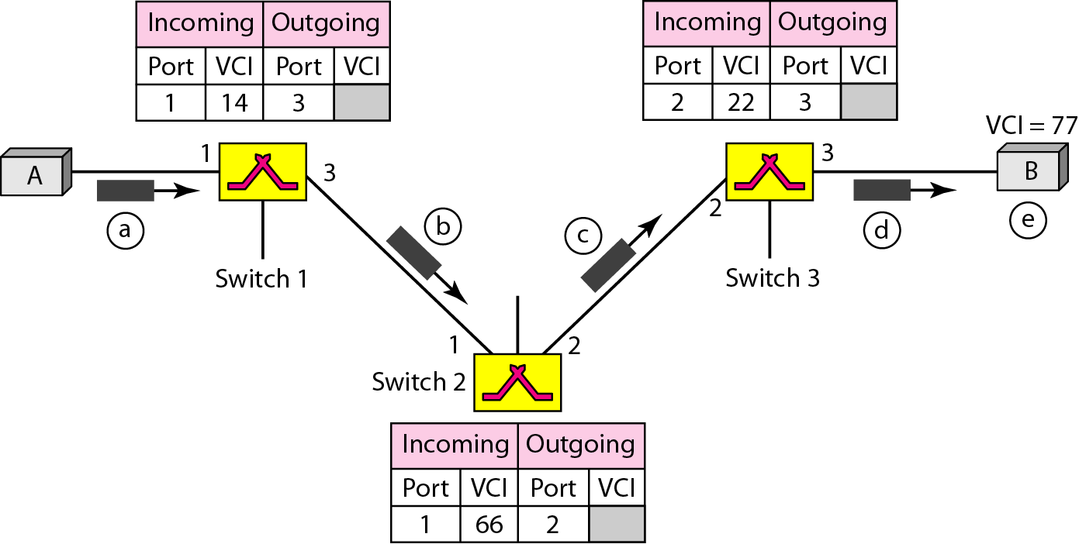
How Virtual Circuit is established
Source A sends a setup frame to switch 1
Switch 1 receives the setup request frame
It knows that a frame going from A to B goes out through port 3
The switch, in the setup phase, acts as a packet switch and it has a routing table which is different from the switching table
The switch creates an entry in its table for this virtual circuit, but it is only able to fill three of the four columns. The switch assigns the incoming port (1) and chooses an available incoming VCI (14) and the outgoing port (3). It does not yet know the outgoing VCI, which will be found during the acknowledgment step.

Slide 42
Switch 2 receives the setup request frame. The same events happen here as at switch 1 and three columns of the table are completed: in this case, incoming port (l), incoming VCI (66), and outgoing port (2).
Switch 3 receives the setup request frame. Again, three columns are completed: incoming port (2), incoming VCI (22), and outgoing port (3).
Destination B receives the setup frame, and if it is ready to receive frames from A, it assigns a VCI to the incoming frames that come from A, in this case 77. This VCI lets the destination know that the frames come from A, and no other sources.

Slide 43
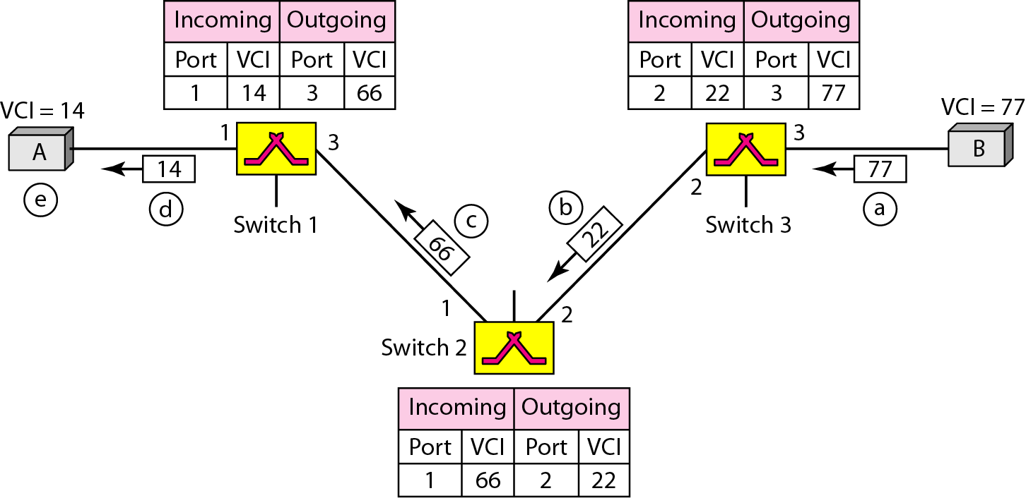
Setup acknowledgment in a virtual-circuit network

Slide 44
The destination sends an acknowledgment to switch 3. The acknowledgment carries the global source and destination addresses so the switch knows which entry in the table is to be completed. The frame also carries VCI 77, chosen by the destination as the incoming VCI for frames from A. Switch 3 uses this VCI to complete the outgoing VCI column for this entry. Note that 77 is the incoming VCI for destination B, but the outgoing VCI for switch
Switch 3 sends an acknowledgment to switch 2 that contains its incoming VCI in the table, chosen in the previous step. Switch 2 uses this as the outgoing VCI in the table.
Switch 2 sends an acknowledgment to switch 1 that contains its incoming VCI in the table, chosen in the previous step. Switch 1 uses this as the outgoing VCI in the table.
Finally switch 1 sends an acknowledgment to source A that contains its incoming VCI in the table, chosen in the previous step.
The source uses this as the outgoing VCI for the data frames to be sent to destination B.

Slide 45
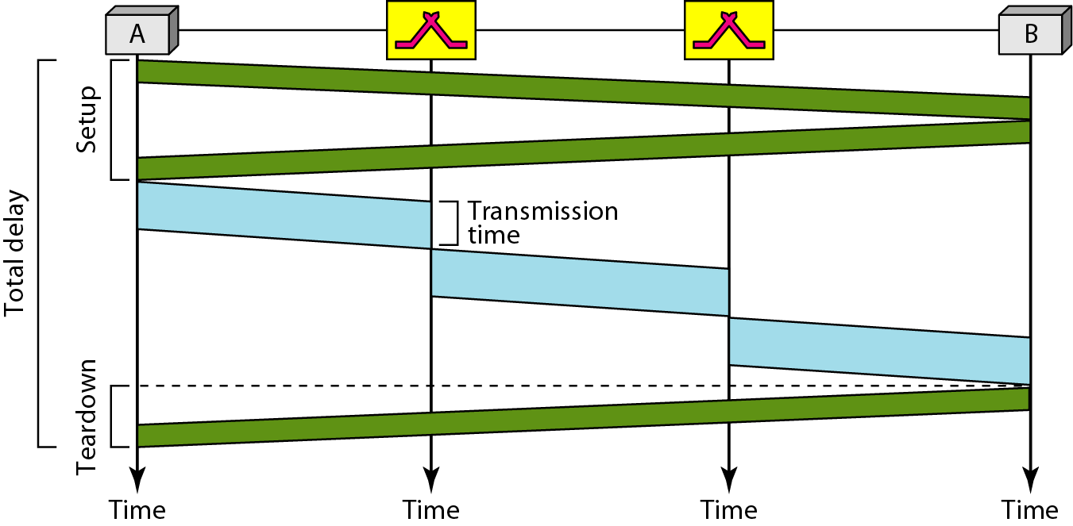

Delay in a virtual-circuit network

Slide 46
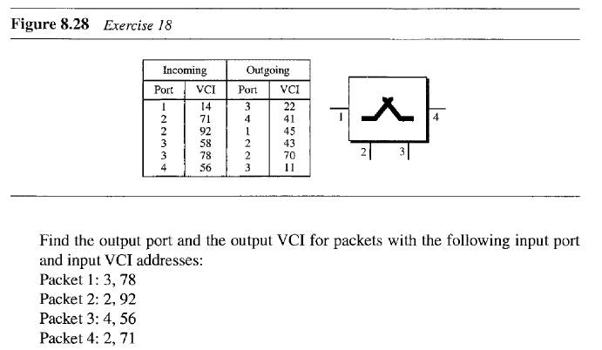
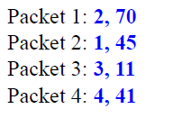
Virtual Circuit switching-Question Solution

Slide 47
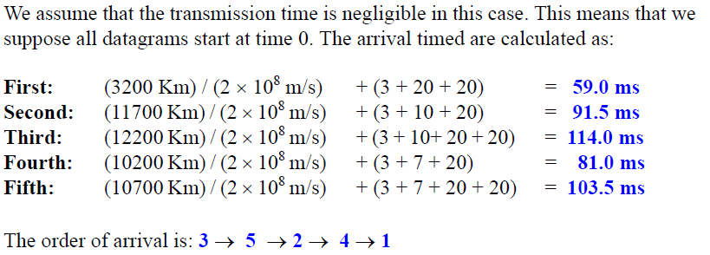
Five equal-size datagram belonging to the same message leave for the destination one after another. However, they travel through different paths as shown in Table
Datagram Path Length Visited Switches
1 3200Km 1,3,5
2 11,700 Km 1,2,5
3 12,200 Km 1,2,3,5
4 10,200 Km 1,4,5
5 10,700 Km 1,4,3,5
We assume that the delay for each switch (including waiting and processing) is 3,10, 20, 7, and 20 ms respectively. Assuming that the propagation speed is 2 x 10⁸ m,
find the order the datagram arrive at the destination and the delay for each. Ignore any other delays in transmission.
Datagram switching-Question Solution

Slide 48
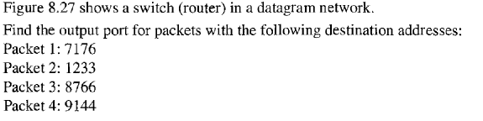
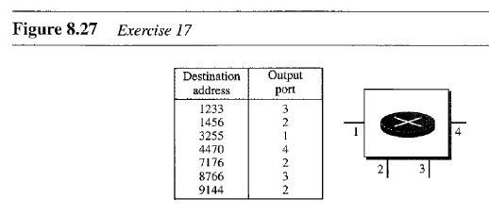
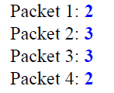
Datagram switching-Question Solution

Slide 49
Advantages of packet switching
Packet switching is cost effective, because switching devices do not need massive amount of secondary storage.
Packet switching offers improved delay characteristics, because there are no long messages in the queue (maximum packet size is fixed).
Packet can be rerouted if there is any problem, such as, busy or disabled links.
The advantage of packet switching is that many network users can share the same channel at the same time. Packet switching can maximize link efficiency by making optimal use of link bandwidth.

Slide 50
Disadvantages of packet switching
Protocols for packet switching are typically more complex.
It can add some initial costs in implementation.
If packet is lost, sender needs to retransmit the data.
Another disadvantage is that packet-switched systems still can’t deliver the same quality as dedicated circuits in applications requiring very little delay - like voice conversations or moving images.

Slide 51
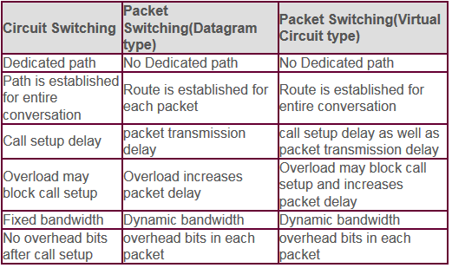
Comparative Analysis
Circuit, Datagram & Virtual Circuit Switching

Slide 52
Message Switching
With message switching there is no need to establish a dedicated path between two stations.
When a station sends a message, the destination address is appended to the message.
The message is then transmitted through the network, in its entirety, from node to node.
Each node receives the entire message, stores it in its entirety on disk, and then transmits the message to the next node.
This type of network is called a store-and-forward network.
A message-switching node is typically a general-purpose computer. The device needs sufficient secondary-storage capacity to store the incoming messages, which could be long. A time delay is introduced using this type of scheme due to store- and-forward time, plus the time required to find the next node in the transmission path.

Slide 53
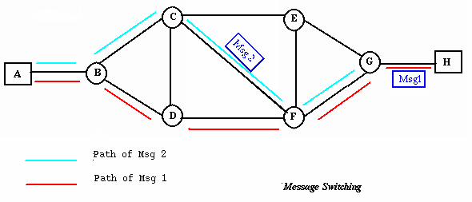
Message Switching

Slide 54
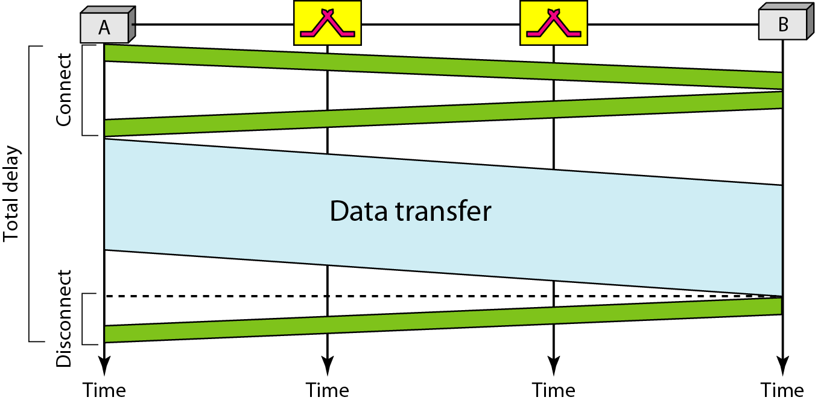
Delay in a circuit-switched network
Total Delay in a circuit-switched network will be delay for setup and tear down +
Propagation delay + Transmission delay i.e.
Total Delay= 3 * Propagation time + 3 * Transmission time + Data Transfer time

